Slide 1
BERT: Pre-training of Deep Bidirectional Transformers for Language Understanding
2018年11月19日

Slide 2
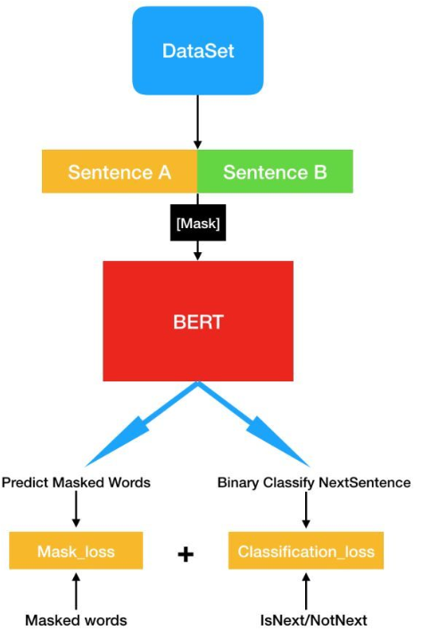
Model architecture
Pre-training Tasks
Masked LM
Next Sentence Prediction
Input representation
Fine-tuning Procedure
Sentence level
Token level
Ablation Studies

Slide 3
Dataset
Books Corpus (800M words)
English Wikipedia (2,500M words)

Slide 4
Pre-training Tasks
Task #1: Masked LM
condition each word bidirectionally to predict the masked words
You can tell a word meaning by its company it keeps

Slide 5
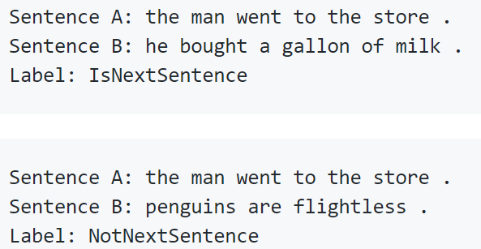
Pre-training Tasks
Task #2: Next Sentence Prediction
model relationships between sentences
Many tasks such as Question Answering (QA) and Natural Language Inference (NLI) are based on understanding the relationship between two text sentences

Slide 6
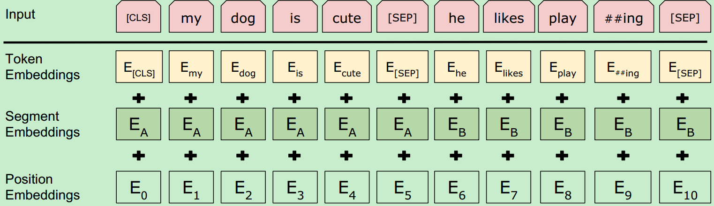
Input representation
The input embeddings is the sum of
token embeddings
Segmentation embeddings
position embeddings.

Slide 7
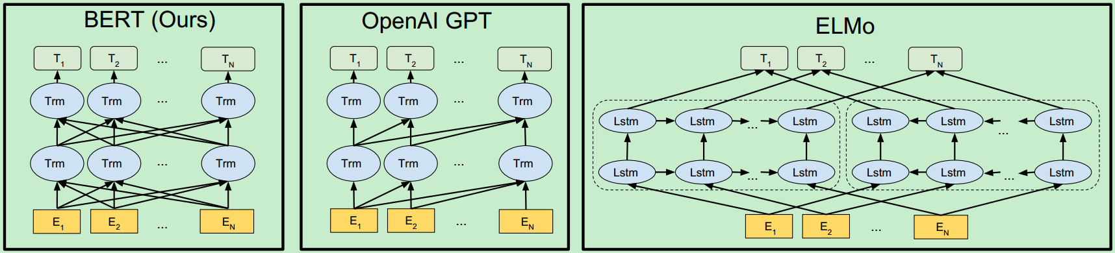
Model
BERT uses a bidirectional Transformer
OpenAI GPT uses a left-to-right Transformer
ELMo uses the concatenation of independently trained left-to-right and right-to-left LSTM to generate features for downstream tasks.
only BERT representations are jointly conditioned on both left and right context in all layers.

Slide 8
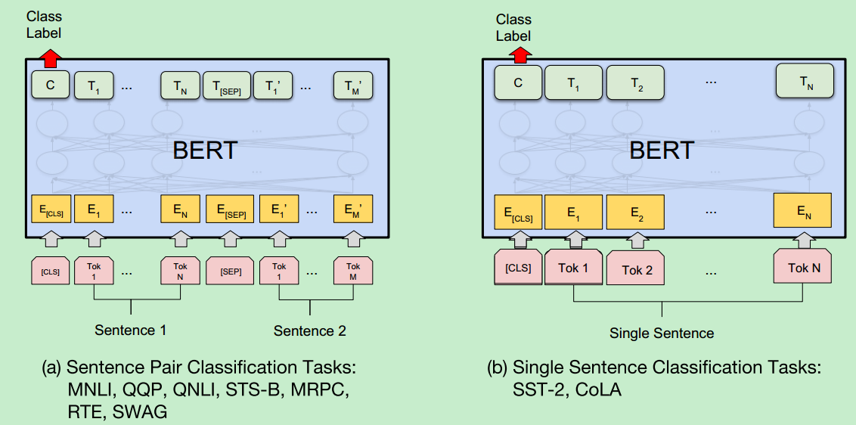
Fine-tuning Procedure (Sentence level)
利用特殊符 [CLS] 所输出的向量 C，即 P = softmax(C * W)，新任务只需要微调权重矩阵 W 就可以了

Slide 9
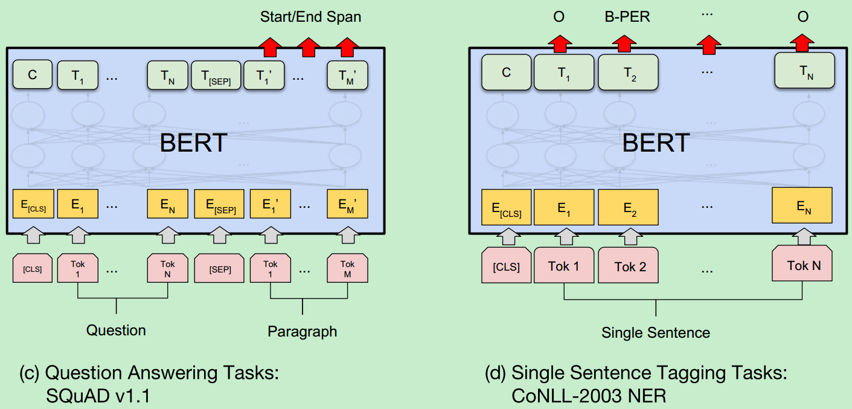
Fine-tuning Procedure (Token level)

Slide 10
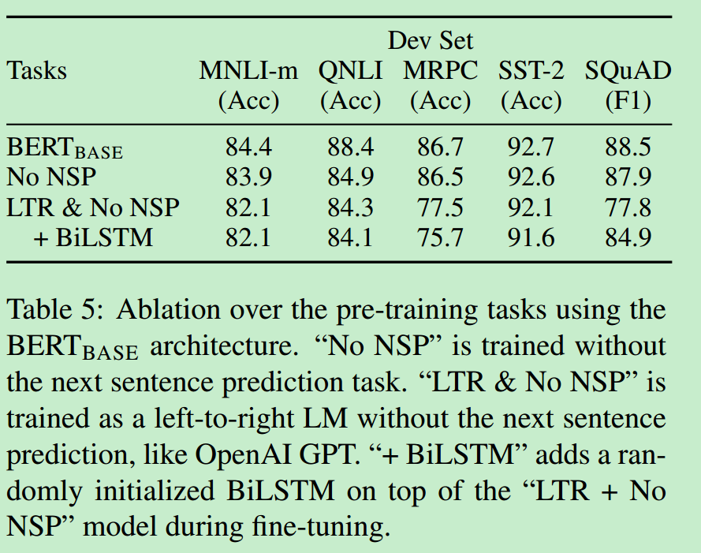
Ablation Studies
Effect of Pre-training Tasks

Slide 11
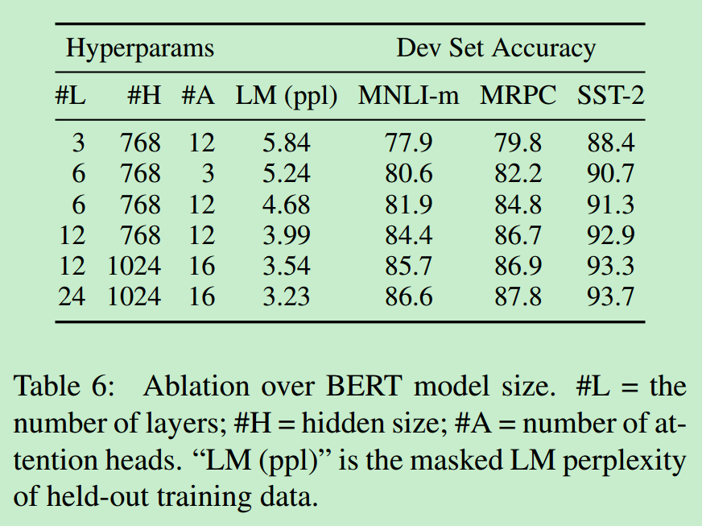
Ablation Studies
Effect of Model Size

Slide 12
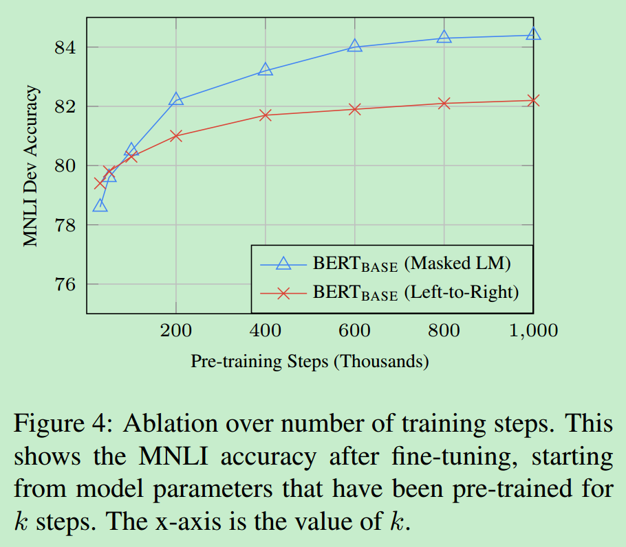
Ablation Studies
Effect of Number of Training Steps
Question: Does BERT really need such a large amount of pre-training (128,000words/batch * 1,000,000 steps) to achieve high fine-tuning accuracy?

